Slide 1
Discrete Mathematics BCSC 0010 Module 2 Group Theory
(Rings and fields)

Slide 2
Ring
Let R be a nonempty set with two binary operations: addition (denoted by “+”) and multiplication (denoted by “.”). Then R is called a ring if:
1) (R,+) is an abelian group
2) (R,.) is a semigroup
3) Distributive law hold in it i.e. for all a,b,c ∈R
a.(b + c) = a.b + a.c
(b + c).a = b.a + c.a
Ring R is represented by (R,+, .)

Slide 3
Types of Ring
Commutative ring
Ring with an identity element
Ring with zero divisors

Slide 4
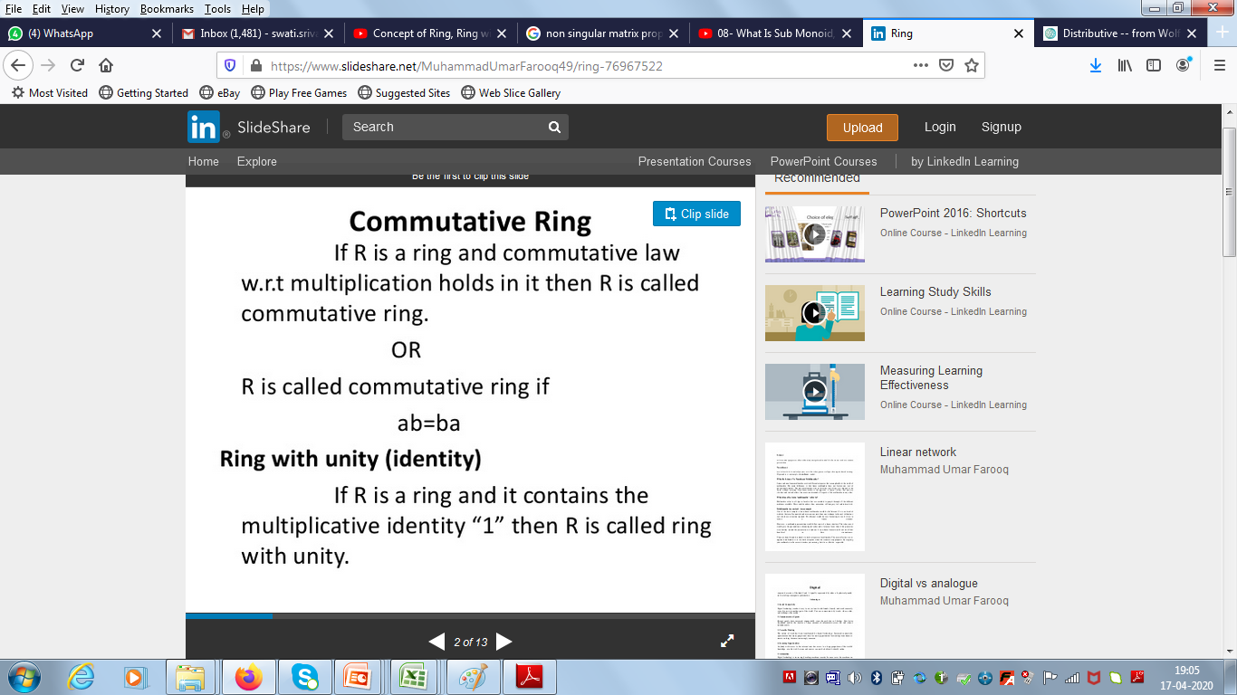
Ring with Unity

Slide 5
Commutative Ring

Slide 6
Ring with Zero Divisor
R is called a ring with zero divisors if there exist nonzero elements a, b ∈ R such that ab = 0. In such a case, a and b are called zero divisors.
Eg. 2 x6 3 = 0
5 ×₅ 4 = 0

Slide 7
Integers modulo n
for any positive integer n, there exists the
Zn called the integers modulo n.
Zn={0,1,2,.....,n-1}
Zn*={1,2,......,n-1}
Eg. Z6 = {0,1,2,3,4,5}
Z6 *= {1,2,3,4,5}

Slide 8
Special Kinds of Ring
Integral Domain
Field

Slide 9
Integral Domain
A commutative ring R is an integral domain if R has no zero divisors, that is, if ab = 0 implies either a = 0 or b = 0.
Eg. Set of Integers is an Integral Domain
Z6={0,1,2,3,4,5} is not an Integral Domain

Slide 10
Field
A commutative ring R with an identity element 1 (not equal to 0) is a field if every nonzero a ∈ R has a multiplicative inverse.

Slide 11
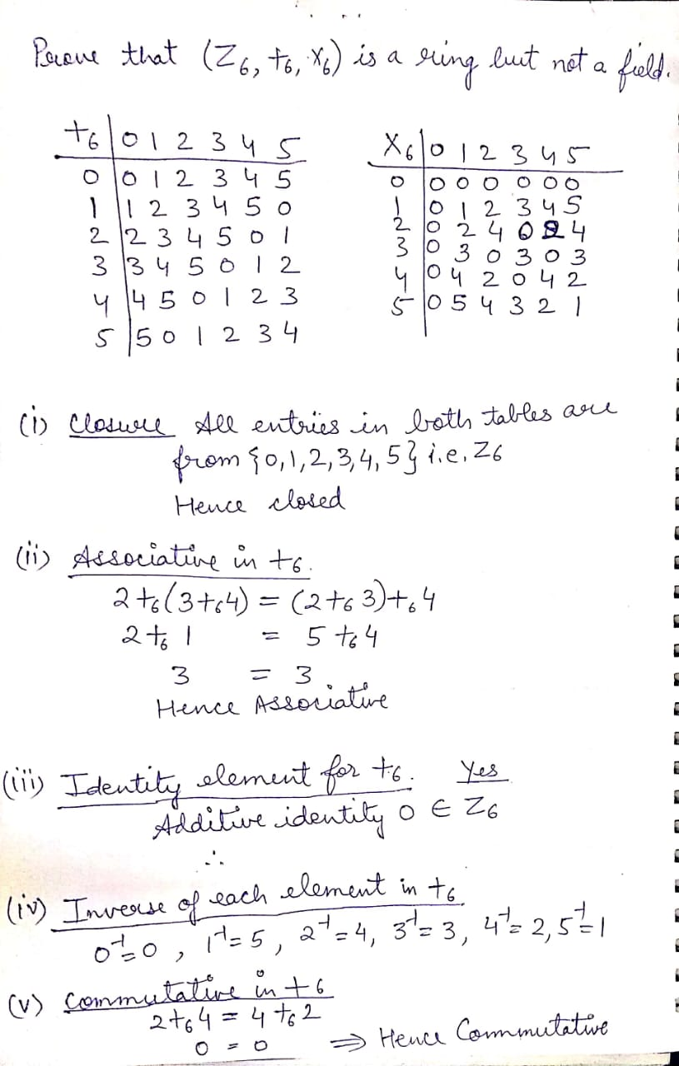
Example
Prove (Z6, +6 , x6 ) is a ring but not a field.

Slide 13
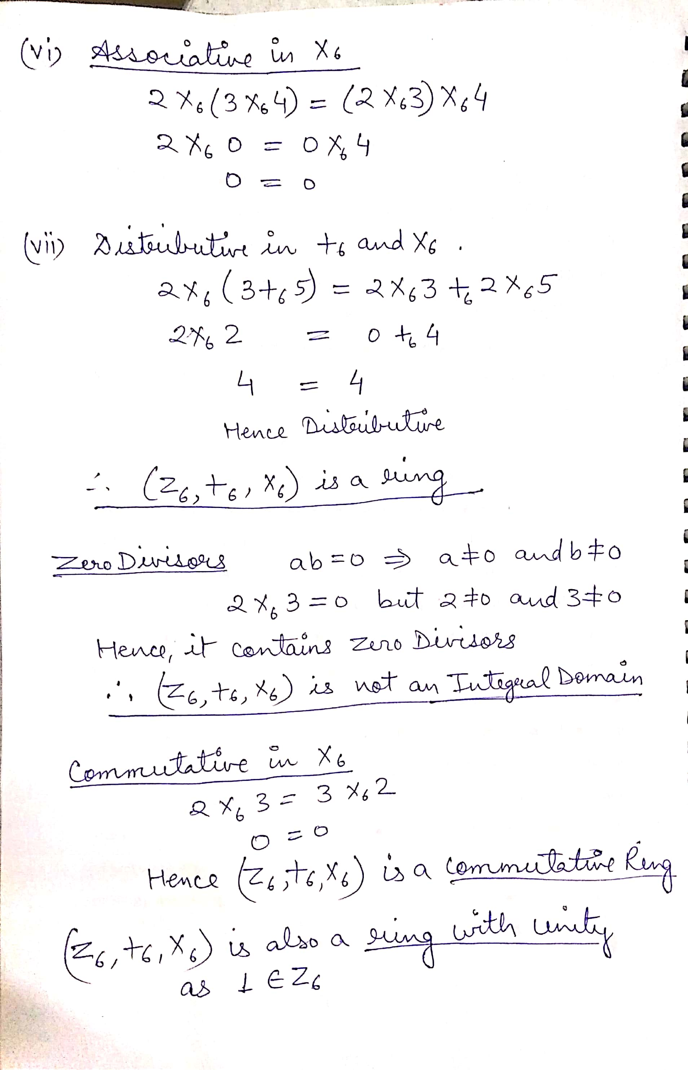

Slide 16
